Slide 1

Goal:
Tegen het einde van deze les kun je communiceren over wat je nu aan het doen bent of wat je irriteert aan anderen.
Wij doen dit door middels van de present continuous

Slide 2
The present continuous
I | am | reading | a book for school
He / She / It | is | reading
You/we/they | are | reading
Het maken van de ''Present continuous'' bestaat uit twee delen: het tegenwoordige tijd van het werkwoord to be + het werkwoord met "ing'' erachter.

Slide 3
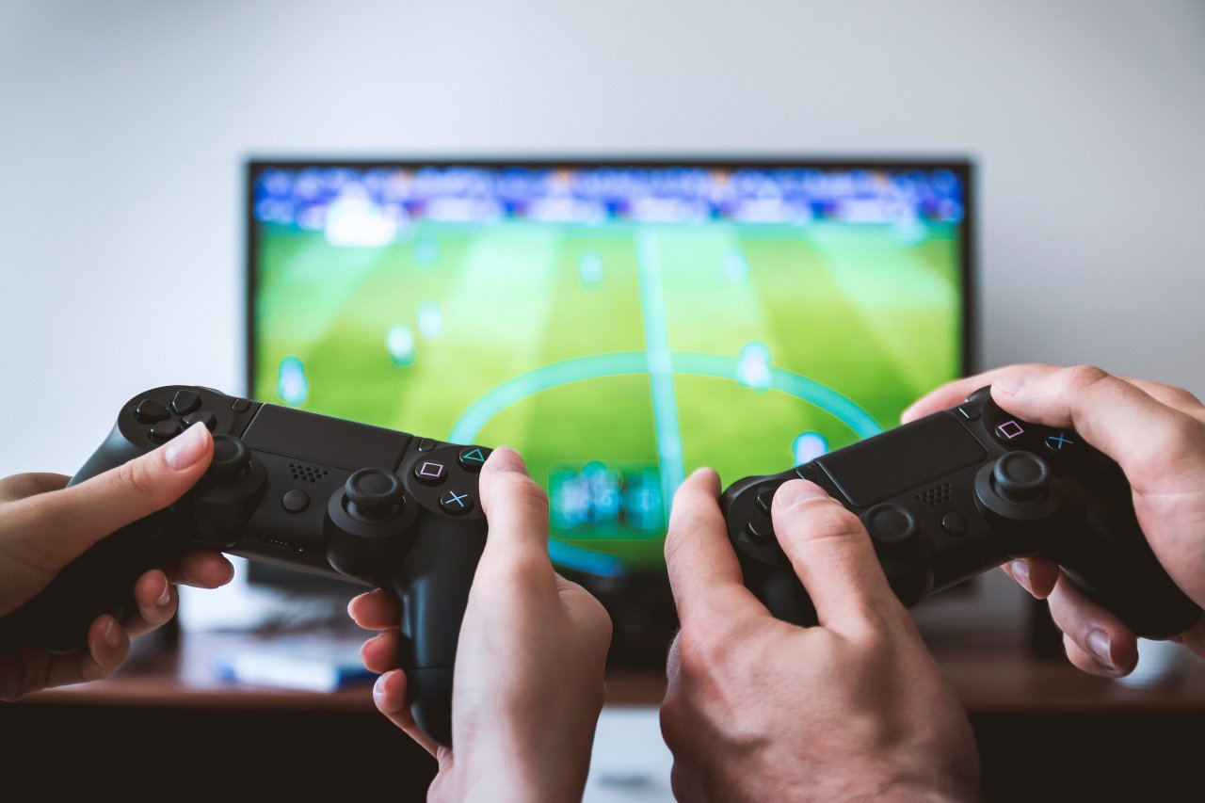
Function and meaning
I am playing a game.
He is running for the police.
She is waiting for the busstop.
They are listening.
We are dancing.
Wat hebben de 5 zinnen in gemeen?
Ze hebben het allemaal over wat er nu gebeurt of plaatsvindt!!

Slide 4
Signaalwoorden voor de present continuous?
I am reading a book right now
Bilal is drawing a picture as we speak
She is having breakfast at the moment

Slide 5
Signaalwoorden voor de present continuous?
I am reading a book right now.
Bilal is drawing a picture as we speak.
She is having breakfast at the moment.

Slide 6
Practice time! Fill in the correct form of the verbs in brackets.
I … the dishes right now. (to eat)
Look! He … Ahmed his present. (to give)
She … her bag all by herself ass we speak. (to carry)
We … in the Alpes this weekend. (to ski)
They … the football match. (to watch)
You … this done before midnight. (to get)
I | am | reading | a book for school
He / She / It | is | reading
You/we/they | are | reading

Slide 7
Answers
I am eating shrimps right now. (to eat)
Look! He is giving Ahmed his present. (to give)
She is carrying her bag all by herself as we speak. (to carry)
We are skiing in the Alpes this weekend. (to ski)
They are watching the football match. (to watch)
You are getting this done before midnight. (to get)

